Slide 1
FT
Instructor:
Michael Greenbaum

Slide 3
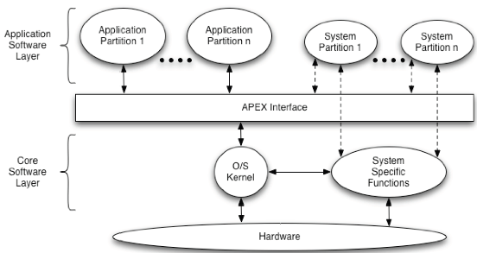
ARINC 653 Architecture

Slide 4
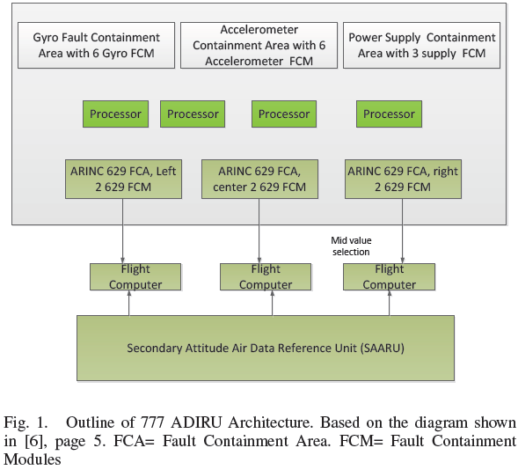
Case Study: Air Data Inertial Reference Unit (ADIRU)
Two ADIRU units: primary and secondary.
The primary ADIRU is divided into 4 Fault Containment Areas (FCA), with each FCA containing multiple Fault Containment Modules (FCM):
  accelerometers (6 FCM),
  gyros (6 FCM),
  processors (4 FCM),
  power supplies (3 FCM),
  ARINC 629 bus (3 FCM).

Slide 5
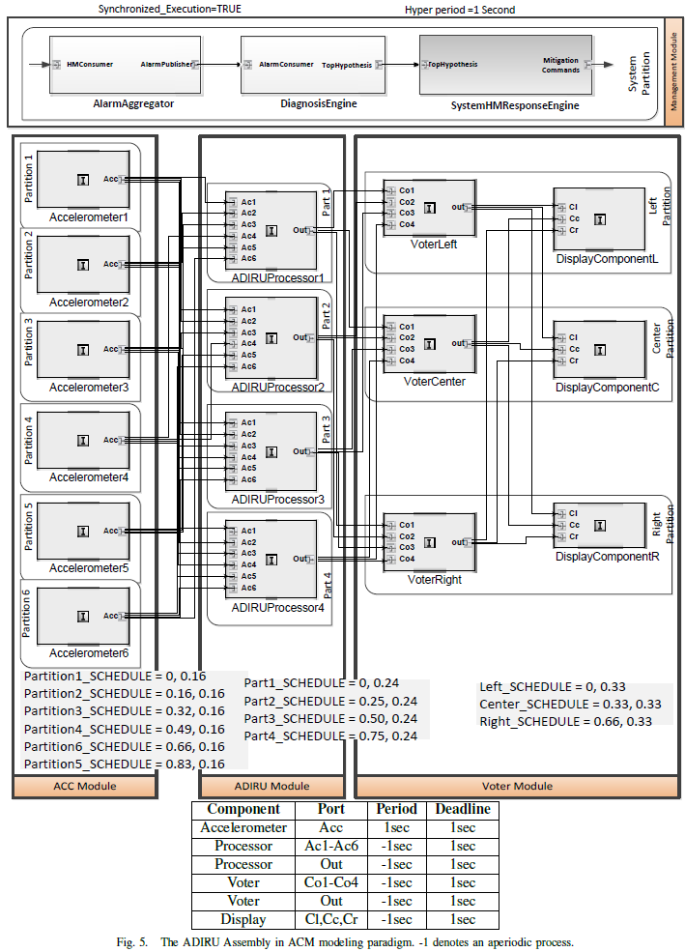

Slide 6
CLHM & SLHM
Component-level health management: (CLHM) provides localized and limited functionality for managing the health of one component by detecting anomalies, mitigating its effects using a reactive timed state machine – on the level of individual components. It also reports to higher-level SLHM
System-Level Health Manager (SLHM) manages the overall health of the system i.e. assembly of all components.

Slide 7
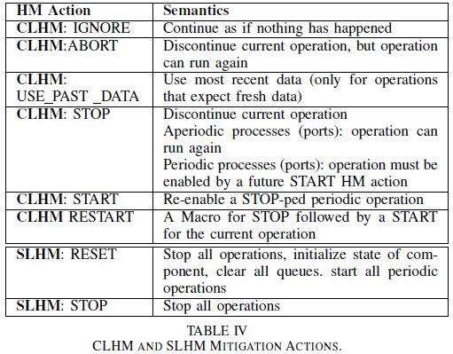
Mitigation Actions

Slide 8
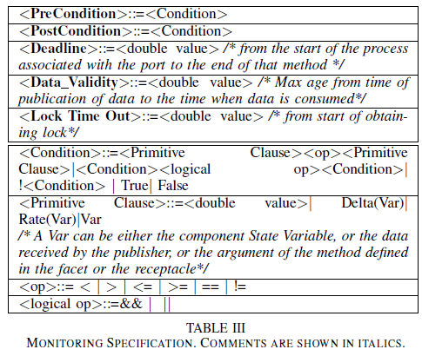

Slide 9
Diagnosis Engine
Diagnosis engine uses TFPG-model to hypothesize the fault-source(s) that could have triggered a specific set of alarms.
It is possible that the observed alarm set (observable discrepancies) could be explained by multiple hypotheses (fault source).
Thresholds based on hypothesis metrics such as Plausibility and Robustness are used to prune the hypotheses set.
Notes:
While additional alarms
certainly help in narrowing out the fault-source,

Slide 10
Timed Failure Propagation
Graph (TFPG)
TFPGs are causal models that capture the temporal characteristics of failure propagation in dynamic systems.
  Nodes represent either failure modes (fault causes), or discrepancies (off-nominal conditions that are the effects of failure modes).
  Edges between nodes capture the propagation of the failure effect
Used to derive efficient reasoning algorithms that implement fault diagnostics:
  fault source identification by tracing observed discrepancies back to their originating failure modes.

Slide 11
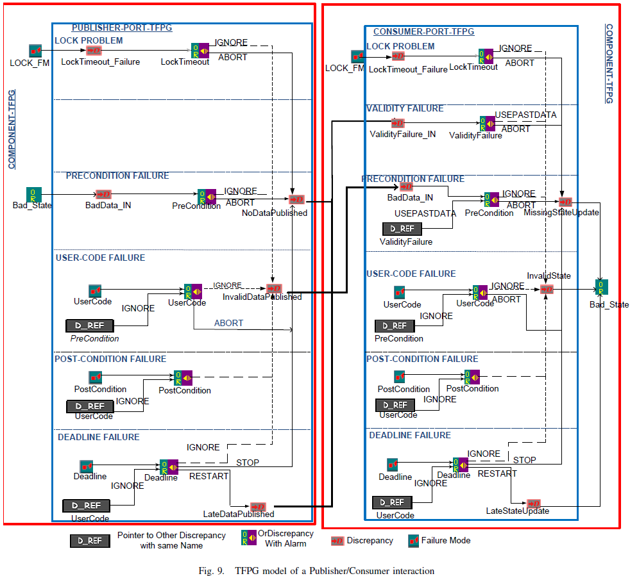

Slide 12
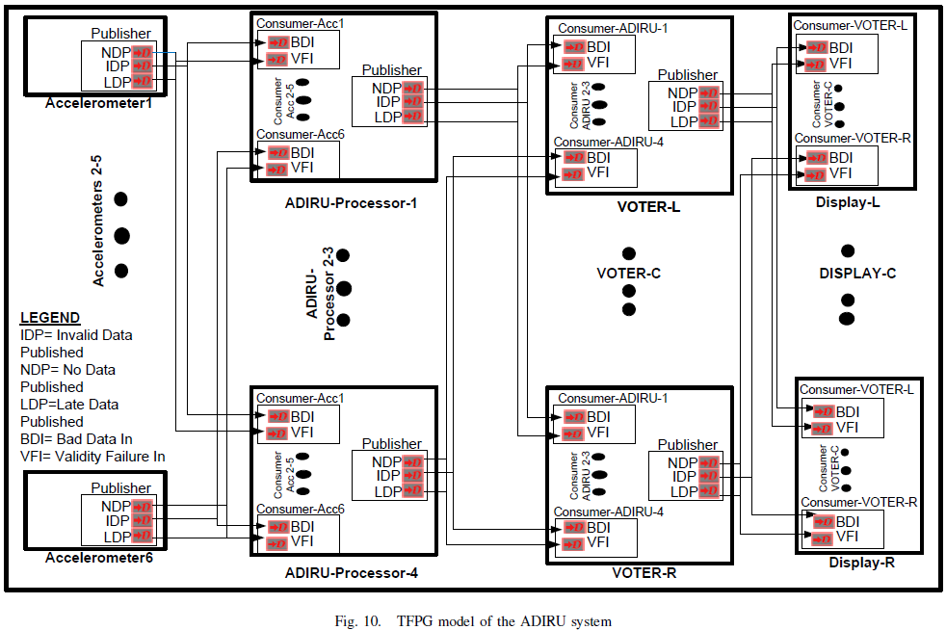

Slide 13
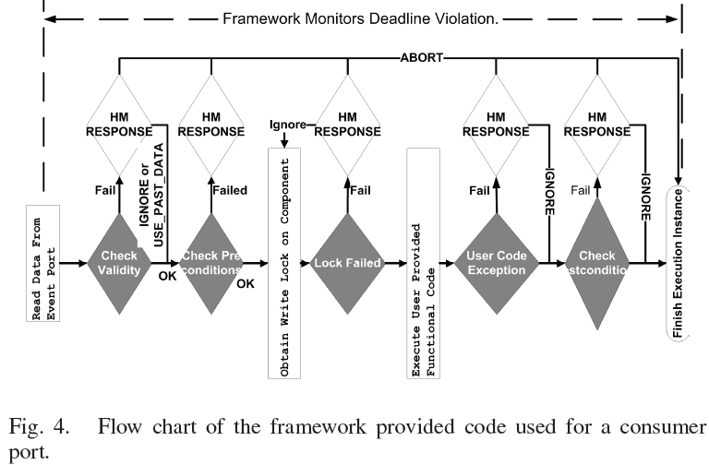
The shaded gray decision boxes are monitors. When an anomaly is detected by a monitor, it is always reported to the local component health manager. Deadline violation is always monitored in parallel by the underlying framework.
White boxes represent the possible mitigation actions taken by the local health manager.

Slide 14
SLHM
An aperiodic consumer, modeled with hierarchical timed state machine, receives the diagnosis results from the Diagnosis-Engine Component, and issues commands to other ARINC 653 processes (defined by ARINC-653)
  RESET, STOP, CHECKPOINT and RESTORE
Notes:
Upon arrival of a new diagnosis result, the consumer triggers the state-machine

Slide 15
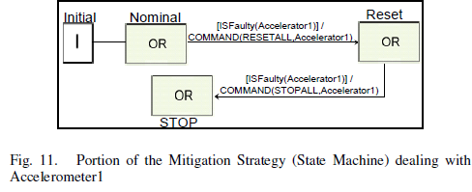
SLHM
An initial command is issued to RESET the Accelerometer component, hoping that this will get the Accelerometer to work correctly.
If despite the reset, the same Accelerometer is identified as a fault-source within a specified time-limit, then command is issued to STOP the Accelerometer.

Slide 16
Experiments
Faults were artificially injected and turned on after a fixed number of iterations , including accelerometer 6 and 5
The Diagnoser was able to determine that the problem was caused by accelerometer 5 and shut it down.
Thereafter, the redundancy management algorithm in the ADIRU processor was able to reconfigure itself to use a different set of regression equations that did not use Accelerometer 5 or 6, and prevented a system-wide failure.

Slide 17
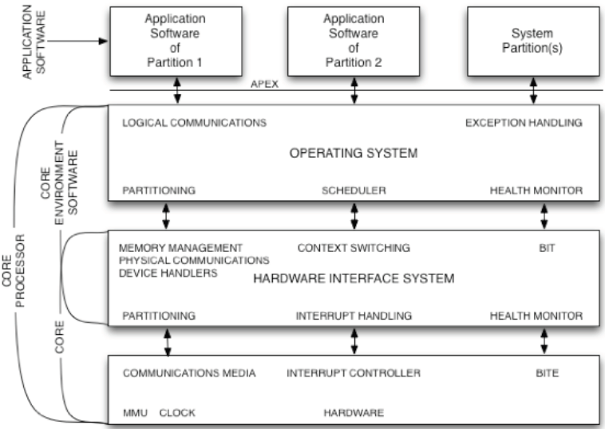
ARINC 653 Layers

Slide 18
FAILSAFE Project
Software Health Management
Matthew R. Barry, PhD, PE
Principal Investigator
Kestrel Technology, LLC
January 2008

Slide 19
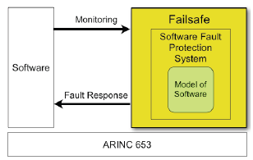
FAILSAFE
Integrate various models of software performance and fault recovery to provide system-level SHM capabilities under ARINC 653 for high-assurance applications

Slide 20
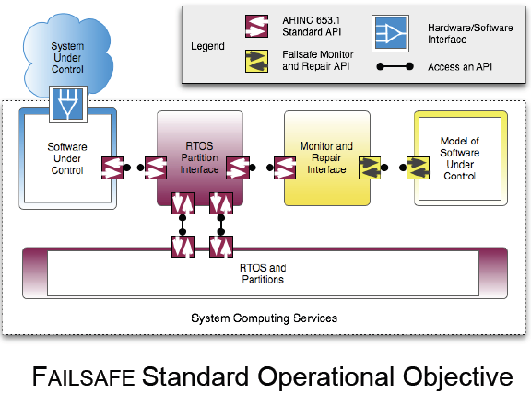
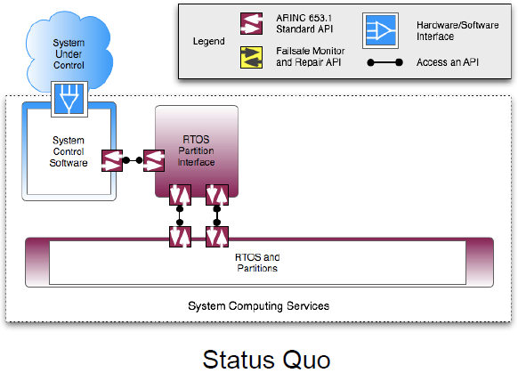
FAILSAFE Framework Components

Slide 21
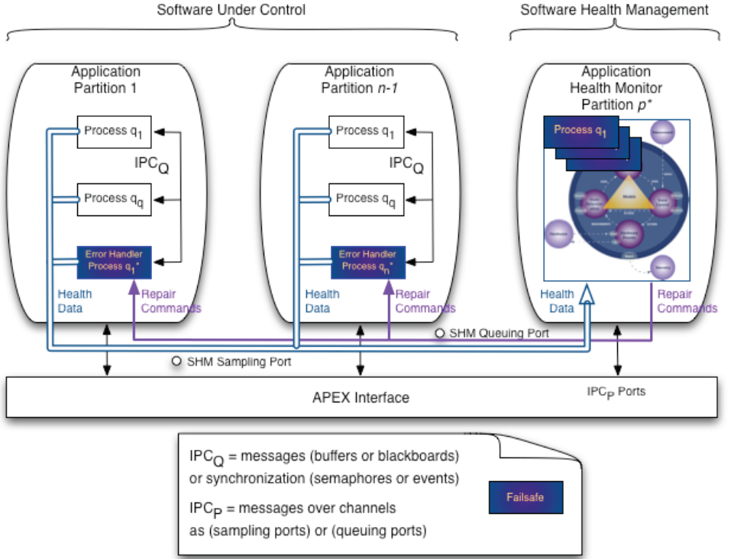
FAILSAFE Framework

Slide 22
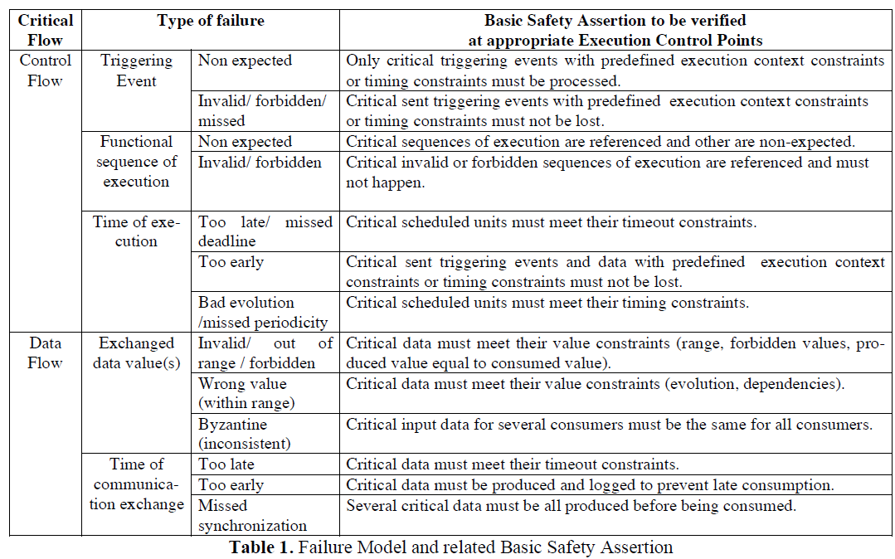

Slide 23
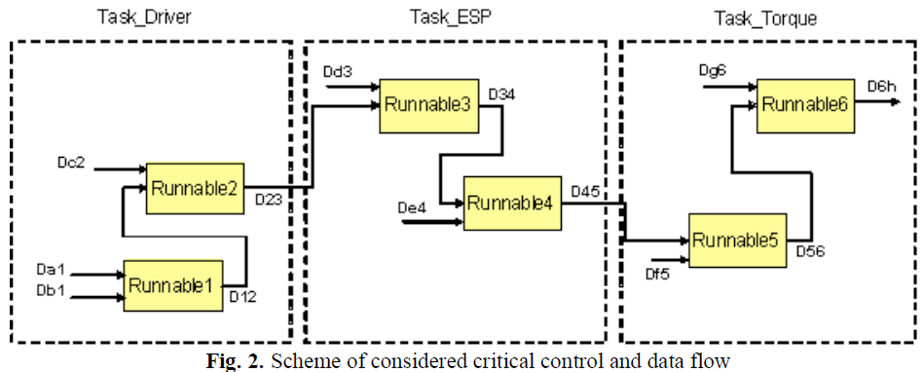
The expected periodic atomic sequence pattern are
S1= {Runnable1, Runnable2}, S2= {Runnable3, Runnable4}, S3= {Runnable5, Runnable6}.
If S1 or S3 atomic sequence is broken, it has to be re-executed.
If S2 is broken, degraded values are taken.
Before S3, if S1 is older than 4 executions of S2, S1 must be re-executed before S3.

Slide 24
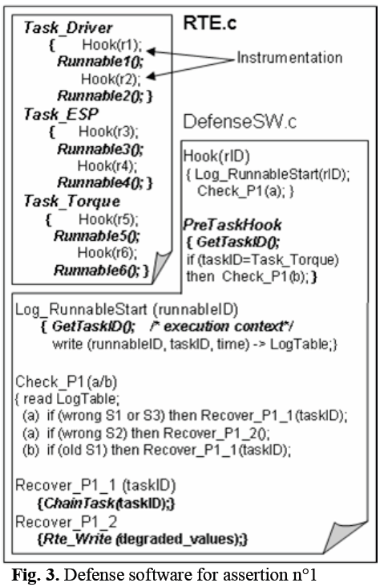

Slide 25
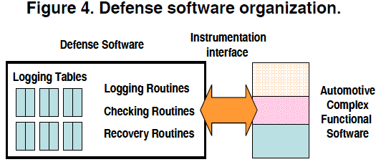
Defensive Software
Logging tables and three types of services
  (i) information logging (“logging routines”),
  (ii) error detection (“checking routines”), and
  (iii) error recovery (“recovery routines”).

Slide 26
Bracket Tables
The execution trace from OS viewpoint:
  when a critical task starts execution, an “opening-bracket table” entry is filled basically with the task identifier and a timestamp. The “closing-bracket-table” stores the same type of information, when the task ends
The execution trace from application viewpoint:
  when a critical application-level function starts and ends.
The control event trace:
  when an activation event (that impacts directly or indirectly the activation of a task) happens, an “opening-bracket-table” entry is filled basically with parameters that characterize the event, the current running task identifier, and a timestamp. The “closing-bracket-table” stores the same type of information, when the termination event occurs.
The data event trace:
  when a critical data is written, an “opening-bracket-table” entry is filled basically with the data, the function identifier that produces the data, the task identifier in which it runs and a timestamp. The “closing-bracket-table” stores the same type of information, when the data is read.

Slide 27
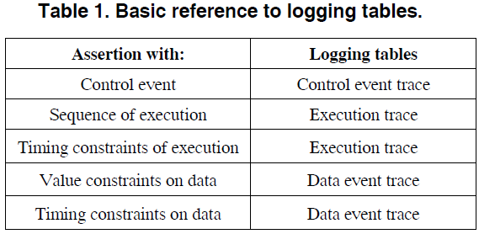

Slide 28
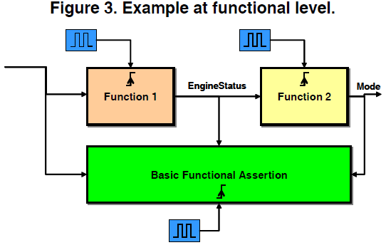
Unwanted System Events (USE)
“The system is blocked (more than 1 second) in mode A, while the engine status is equal to 2, whereas it should switch to mode B”.

Slide 29
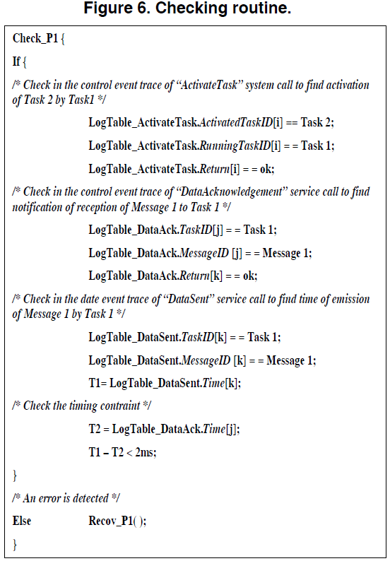
Error Detection
Property to be checked
“The acknowledgement of reception of Message 1, notified to Task 1, at latest 2ms after Message 1 has been sent, allows Task1 to activate Task 2, else Task 3 must be activated”.

Slide 30
Error Recovery
Each “checking routine” is associated with one or more “recovery routines”.
  Recov_P1
    {/* Error: Task 2 must not be activated but Task 3 */
    ActivateTask (Task3); }
Control flow error recovery.
Dataflow error recovery

Slide 31
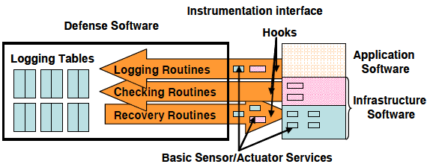

Slide 32
Control Flow Recovery Strategy
Actions on control flow concern the life cycle of tasks and can be classified into 3 categories:
  End of task execution:
    terminate the erroneous task.
  Start of task execution:
    launch a degraded task if switch to degraded mode is decided; or to launch the expected task after error detection on sequence of execution; or else to launch again the same task from the beginning
  Suspension of task execution:
    temporarily stop the current execution, to allow the execution of another action/task.
Notes:
to reexecute the same treatment with right entries. The
activation of a task may be synchronous or
asynchronous.
·

Slide 33
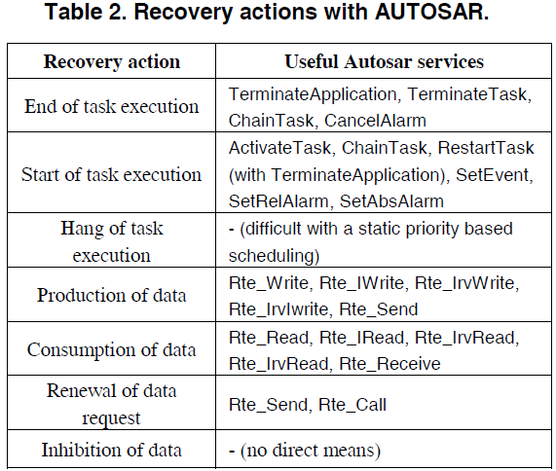

Slide 34
Data Flow Recovery Strategy
Actions on data flow relate data value or timing:
  Production of correct or degraded data:
    Overwrite the preceding erroneous data by the right one.
  Consumption of correct or degraded data:
    Call the data consumption instruction again to get the correct value which is has been updated by the recovery strategy.
  Renewal of data request:
    Call the data production or consumption instruction again, when timeout reception or acknowledgement of emission is missed.
  Inhibition or delay of data:
    When invalid or untimely data is received, the recovery strategy acts a filter, to transmit only right data to the application.

Slide 35
References
Jean-Charles Fabre, Marc-Olivier Killijian, François Taïani: Robustness of automotive applications using reflective computing: lessons learnt. SAC 2011: 230-235
Miruna Stoicescu, Jean-Charles Fabre, Matthieu Roy: Architecting Resilient Computing Systems: Overall Approach and Open Issues. SERENE 2011: 48-62
Jean-Charles Fabre, Marc-Olivier Killijian, Thomas Pareaud: Towards On-line Adaptation of Fault Tolerance Mechanisms. EDCC 2010: 45-54
Caroline Lu, Jean-Charles Fabre, Marc-Olivier Killijian: Robustness of Modular Multi-layered Software in the Automotive Domain: a Wrapping-based Approach. ETFA 2009: 1-8

